Slide 1



Agile Development

Slide 2
What is Agile?
Agile is an approach to many different types of team-based projects including Software Development
SCRUM is an agile approach that is heavily team focused and has set roles for each team member
A SCRUM team typically consists of a: Product Owner, Scrum Master, Dev Team, and Testers

Slide 3
Agile vs Traditional Methods (Waterfall)
Traditional Methods include more planning upfront, Agile only plans to the bare minimum
Traditional Methods keep the project to the original plan, Agile allows the plan to change
Traditional Methods keep the Project Manager responsible for all, Agile holds every member of the team accountable
Traditional Methods have communication with the client at the beginning of the process, Agile methods have ongoing communication throughout

Slide 4
SCRUM Roles
Product Owner responsible for communicating with the client and ensuring their vision is correctly relayed to the scrum team through the scrum master, they also are responsible for manicuring the product backlog
Scrum Master responsible for ensuring that the scrum team has everything they need to succeed, removes potential obstacles to their work, facilitates meetings with the team, and also responsible for manicuring the product backlog
Dev Team responsible for writing code and software architecture that meets the vision of the client, updates tasks as they get done and communicates potential needs and roadblocks to rest of team
Testers responsible for writing test code and testing the software as it is being developed

Slide 5


Agile SDLC Phases
PLANNING an agile approach will only plan to the extent that a project needs to be planned understanding that the plan can change
ANALYSIS an agile approach will only analyze what is needed for each sprint (a short burst of work, usually 1-2 weeks that counts as one iteration of the software)
DESIGN an agile approach will iterate on the design of the software during each sprint and will incorporate client feedback into design decisions
DEVELOPMENT an agile approach will develop software in short iterative increments known as sprints
TESTING an agile approach will test software on an ongoing basis throughout development
INTEGRATION an agile approach will finish modules during each sprint which will be integrated together at the end of the project
MAINTENANCE an agile approach will provide ongoing support to the client for the finished product and will include a log of all past bugs and possible future ones as well as built-in regression testing

Slide 6
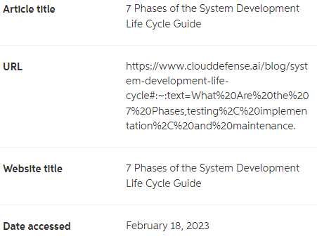
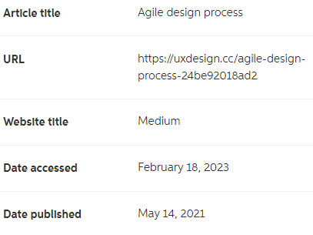
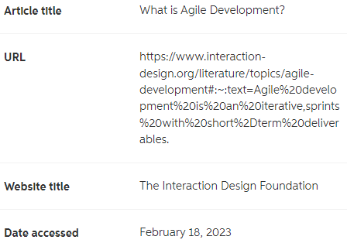
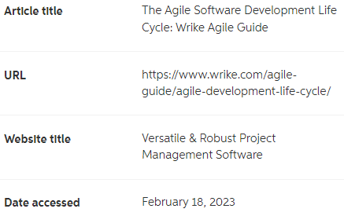

REFERENCES

